Slide 1
Spring 2021 Industry Outlook Survey

Slide 2
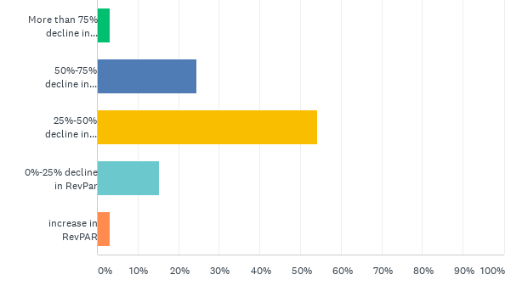
Q1: What is your 2021 full year forecast for REVPAR versus 2019 for your entire portfolio?

Slide 3
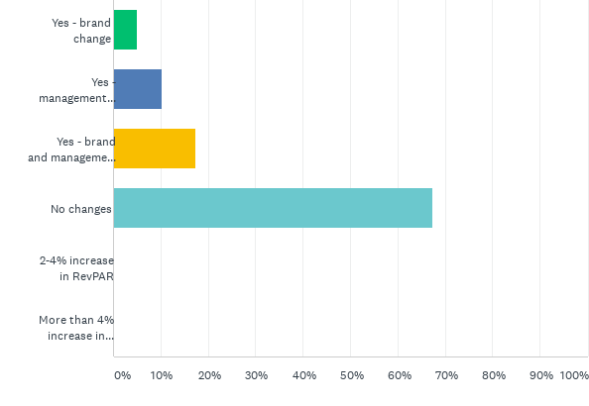
Q2: Are you contemplating a brand or management change as part of your recovery strategy?

Slide 4
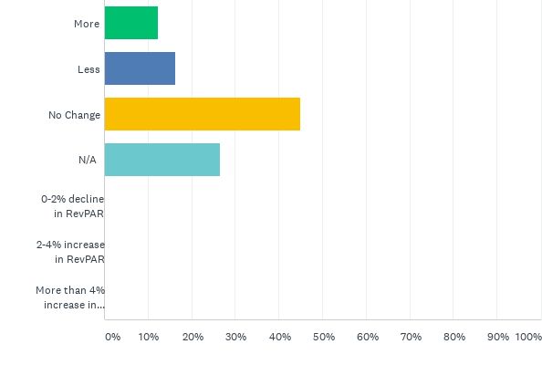
Q3: For your properties with non-CMBS debt, are you finding your lenders to be flexible than they were in Q4 2020

Slide 5
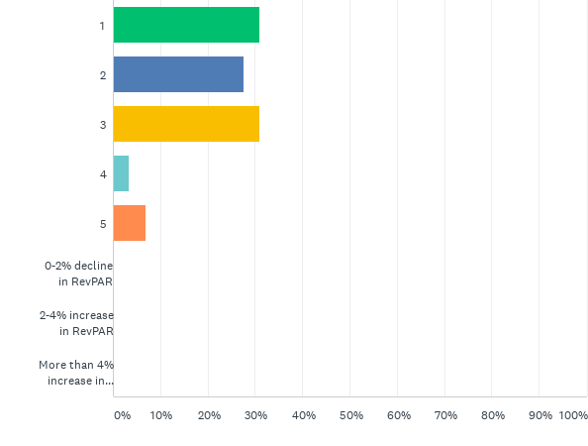
Q4: If you answered less to question number 3 above, how much trouble are you in on a scale of 1 to 5 with 1 being "not much" and 5 being "doomed."

Slide 6
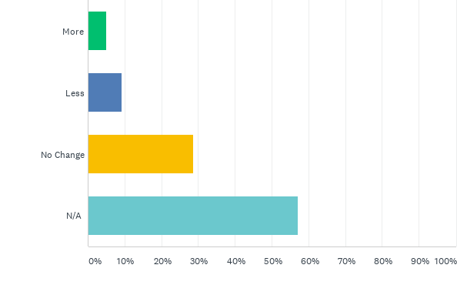
Q5: For your properties with CMBS debt, are you finding your lenders to be flexible than they were in Q4 2020

Slide 7
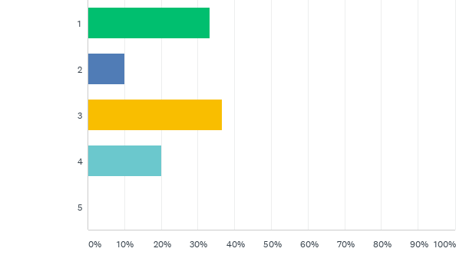
Q6: If you answered less or no change to question number 5 above, how much trouble are you in on a scale of 1 to 5 with 1 being "not much" and 5 being "doomed."

Slide 8
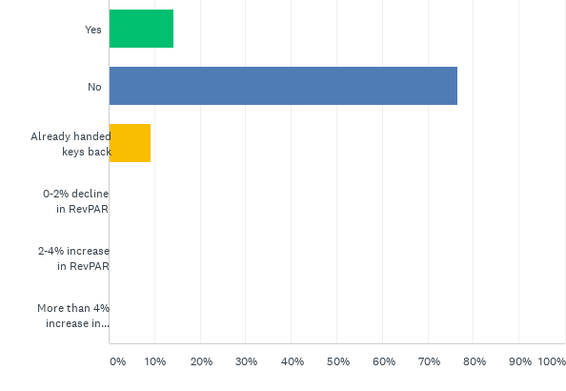
Q7: Do you have any hotels that you expect to hand the keys back to the lender or enter into a forced sale situation?

Slide 9
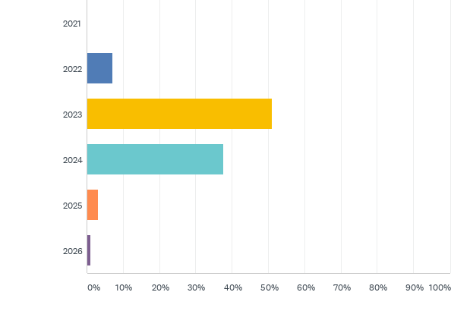
Q8: When do you think RevPAR will return to 2019 levels for the US as a whole?

Slide 10
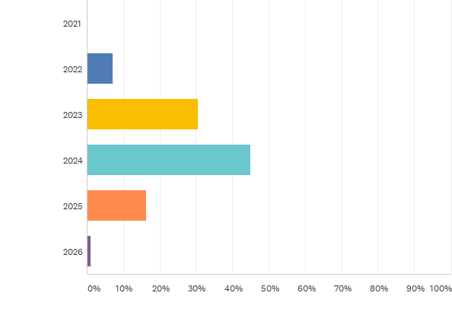
Q9: When do you think RevPAR will return to 2019 levels in the top 25 markets?

Slide 11
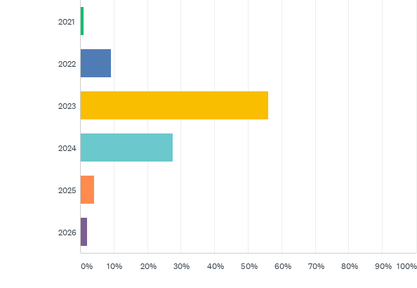
Q10: When do you think RevPAR will return to 2019 levels outside of the top 25 markets?

Slide 12
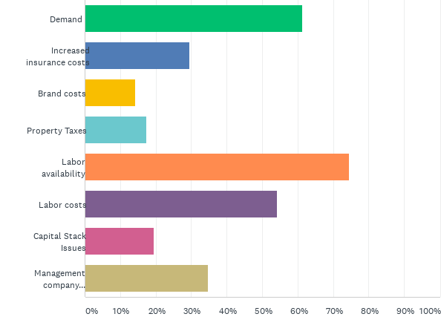
Q11: Of the following, what factors are you most concerned about right now? Please select 3

Slide 13
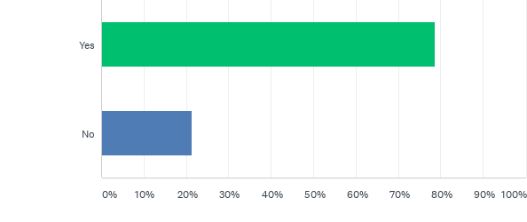
Q12: Are you actively pursuing acquisitions?

Slide 14
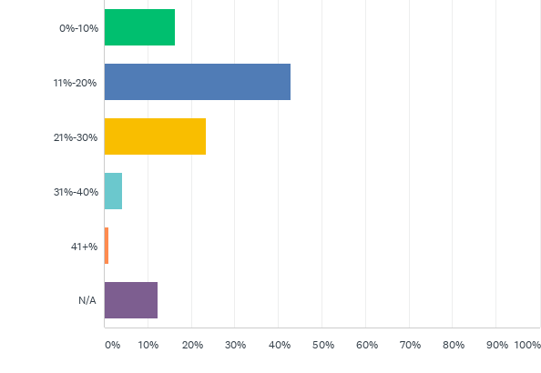
Q13: On average, in urban markets, for full-service and luxury properties, what acquisition price discount do you anticipate compared to 2019 value?

Slide 15
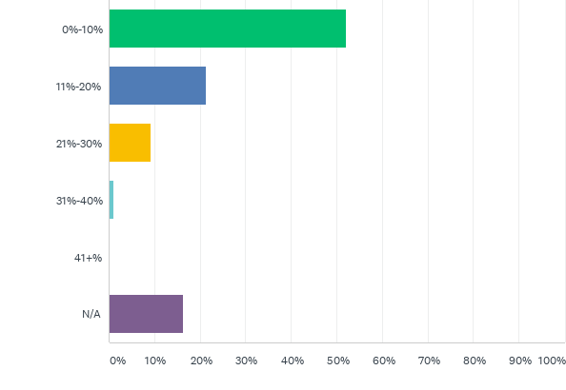
Q14: On average, in resort locations, for full-service and luxury properties, what acquisition price discount do you anticipate compared to 2019 value?

Slide 16
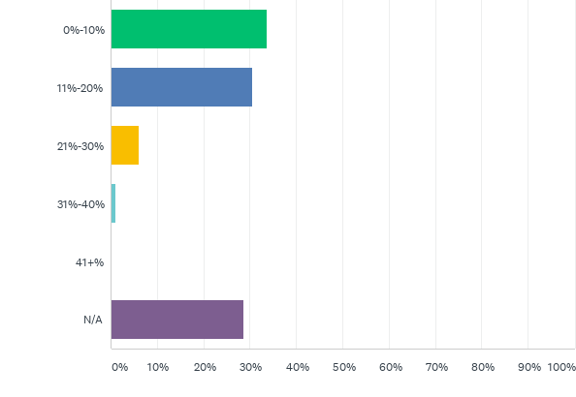
Q15: On average, for select-service and below properties, what acquisition price discount do you anticipate compared to 2019 value?

